Slide 1
cfDNA as a diagnostic tool for early cancer detection
Hack Students: Aamna Alskhekhi, Calina Copos, Madhav Kothari, Revanz Ahmed, Seth Hilliard
Hack Investigators: Alejandro Balbin, Rebecca Leary, Markus Riester, Ben Gustafson, Katie Daco

Slide 2
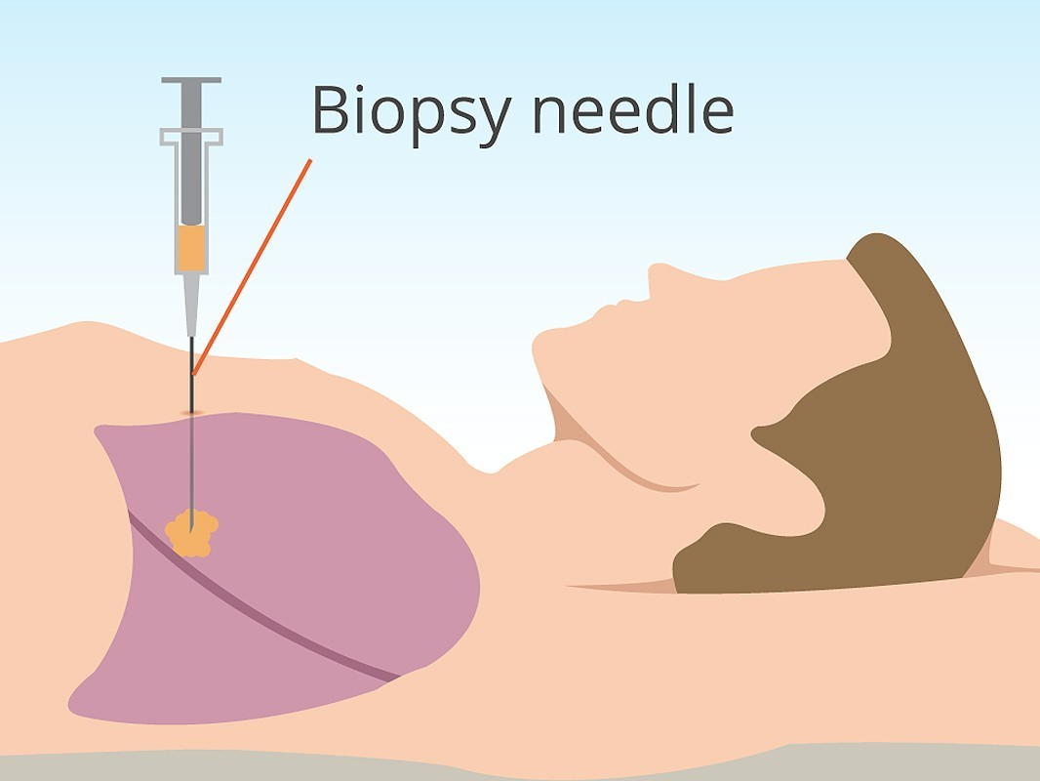
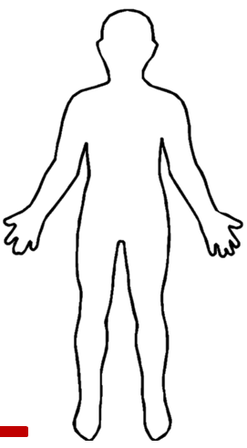
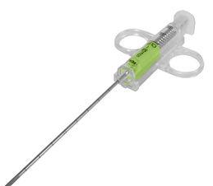
Current issues with the Gold Standard
What is the optimal therapy?
Response? Resistance?
‹#›

Slide 3
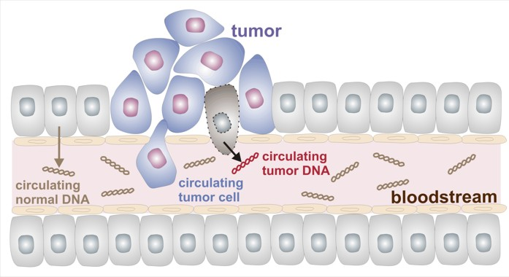
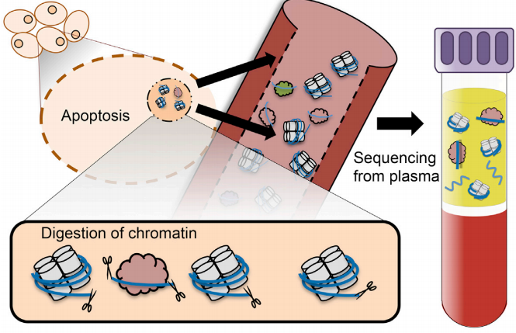
What is cfDNA and ctDNA?

Slide 4
Slide about how cfDNA is already used to identify cancer, but it is costly and time consuming

Slide 5
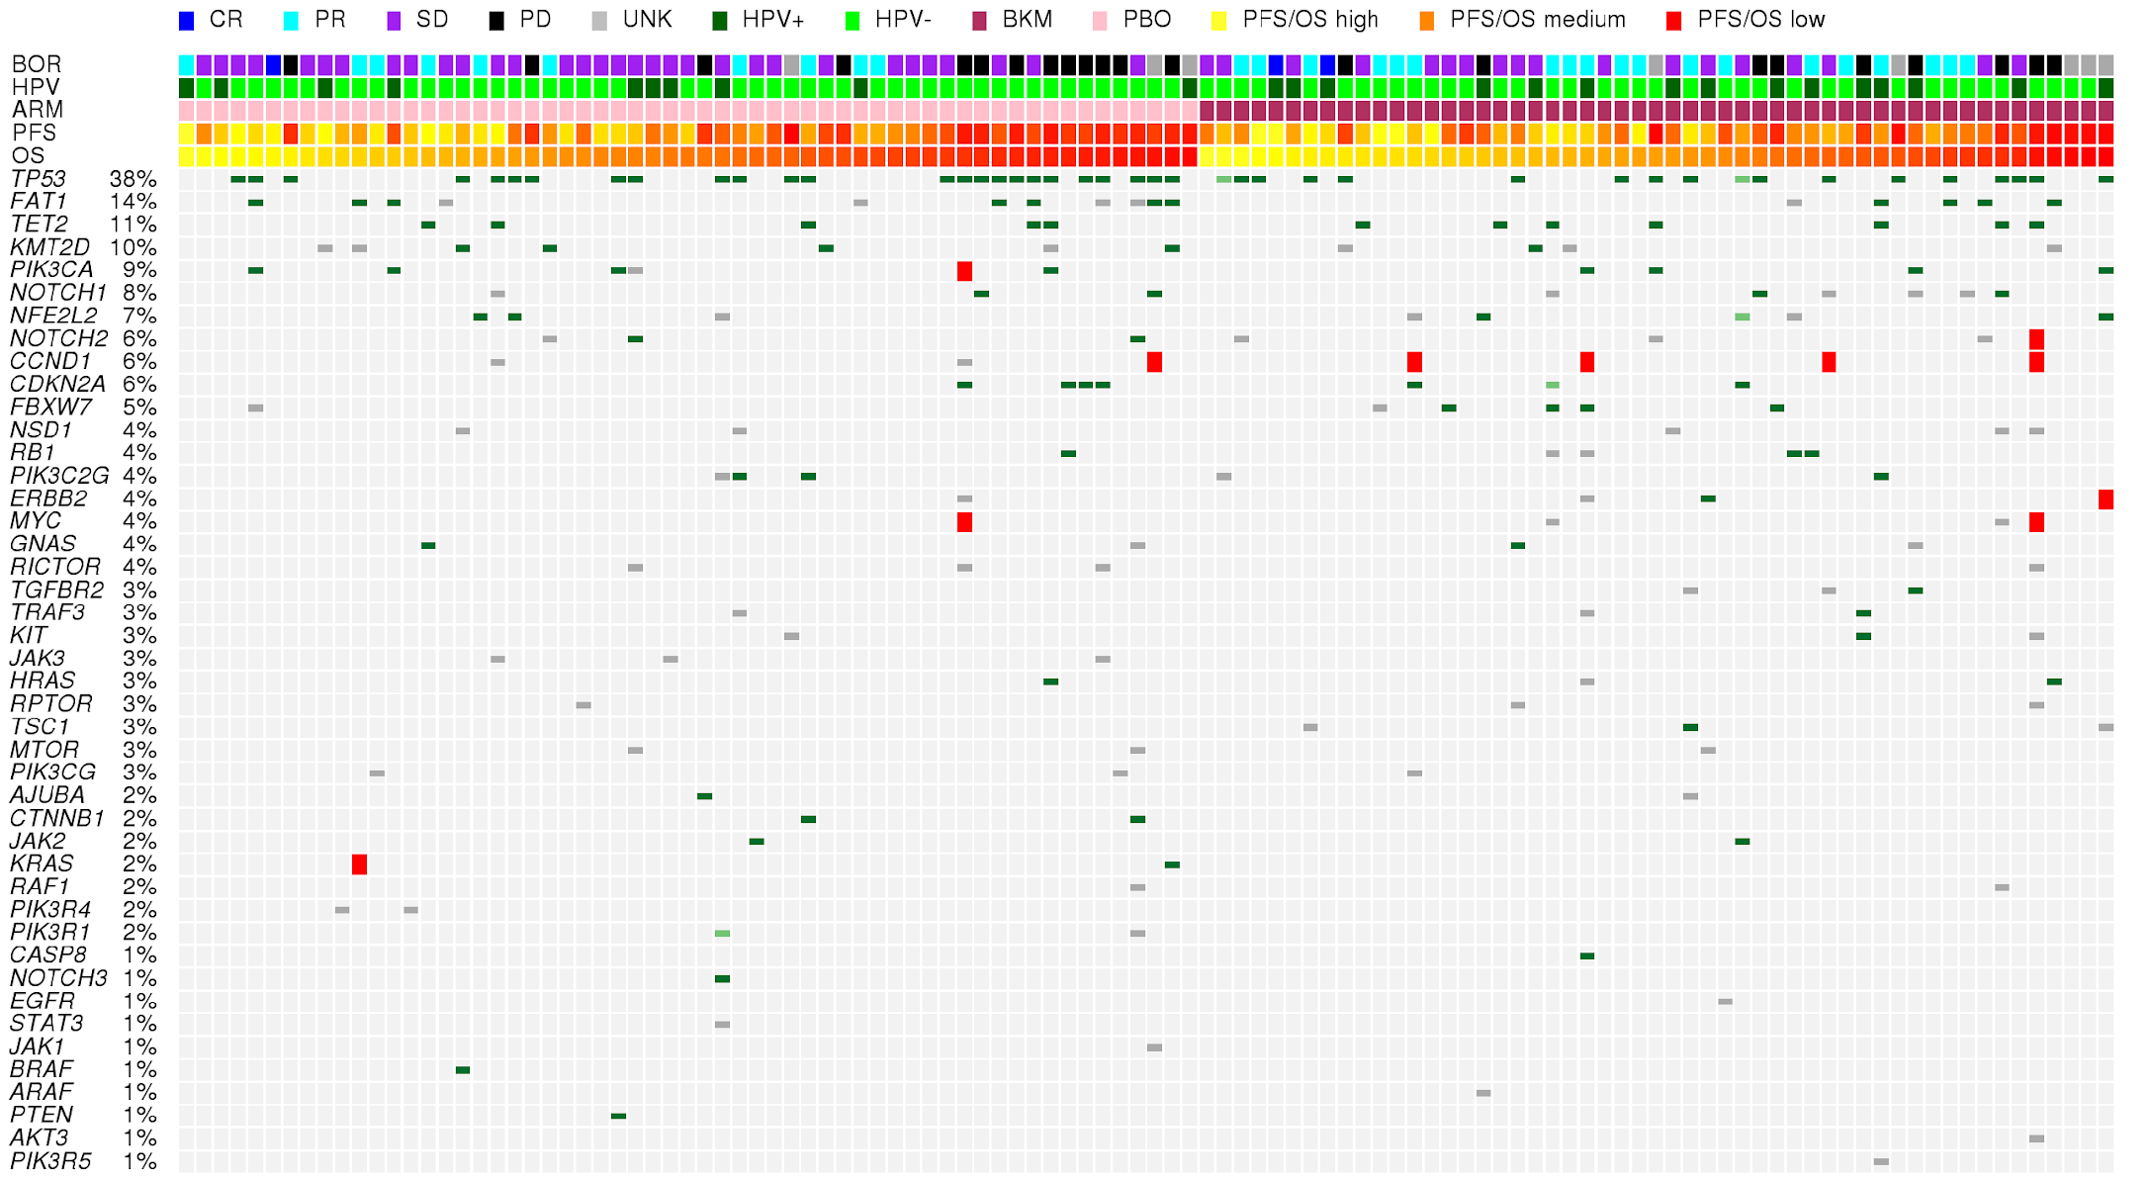
Novartis Assay
Characterizes cfDNA through 600 genes
How far can we push the assay? What if no known mutations are found?
Can we determine ctDNA more accurately?

Slide 6
Learning the rules of the game
Began with a dataset consisting of ~300 patients
Each patient had ~8000 entries
Each entry had information about cfDNA fragments
Gene ID, Exon Number, WPS
Window Protection Score (WPS) is a metric representing the # of fragments spanning a base pair region - # of fragments terminating in that region
Divide this number by sequencing depth to normalize
We needed to clean some of the data and figure out what features we wanted to look at

Slide 7
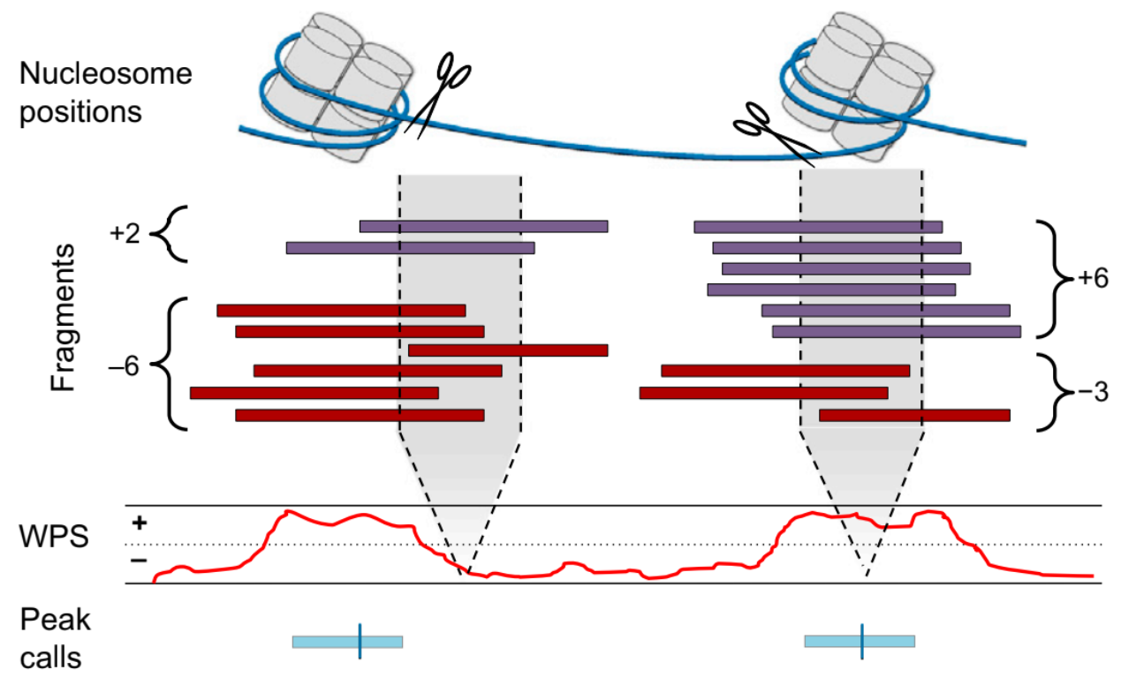
WPS Visualization

Slide 8
Feature Engineering
We had a WPS for each base pair of an exon, and to use ML we needed one entry per element
Decided to do some math and create the following features, per exon, per gene, and per chromosome
Mean
Amplitude
AUC
Variance
Power
Peak frequency from FFT
Nan Percentile (WTH IS THIS?)

Slide 9
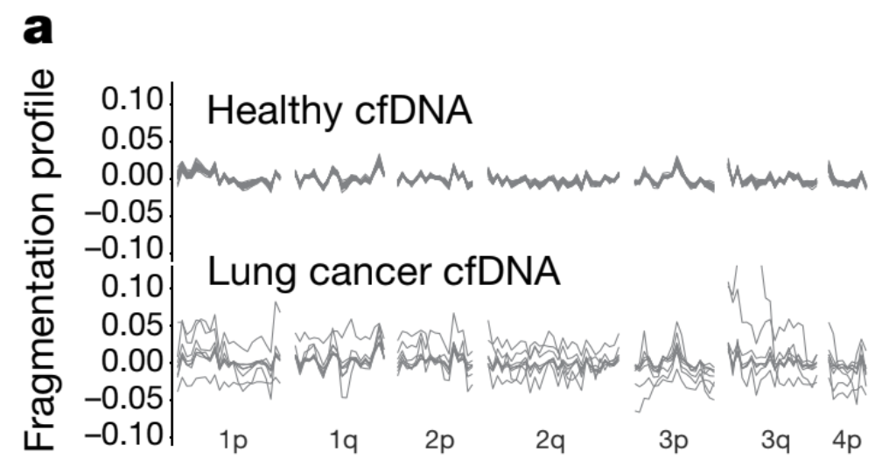
Feature Engineering reasoning
Found key metrics in other papers were based on oddities from cancer cfDNA
Thought that perhaps variance or range of WPS would be more important than average WPS itself

Slide 10
Results

Slide 11
How we each contributed to the work

Slide 12
Future Directions (BAM File, other assays, etc)

